Slide 1
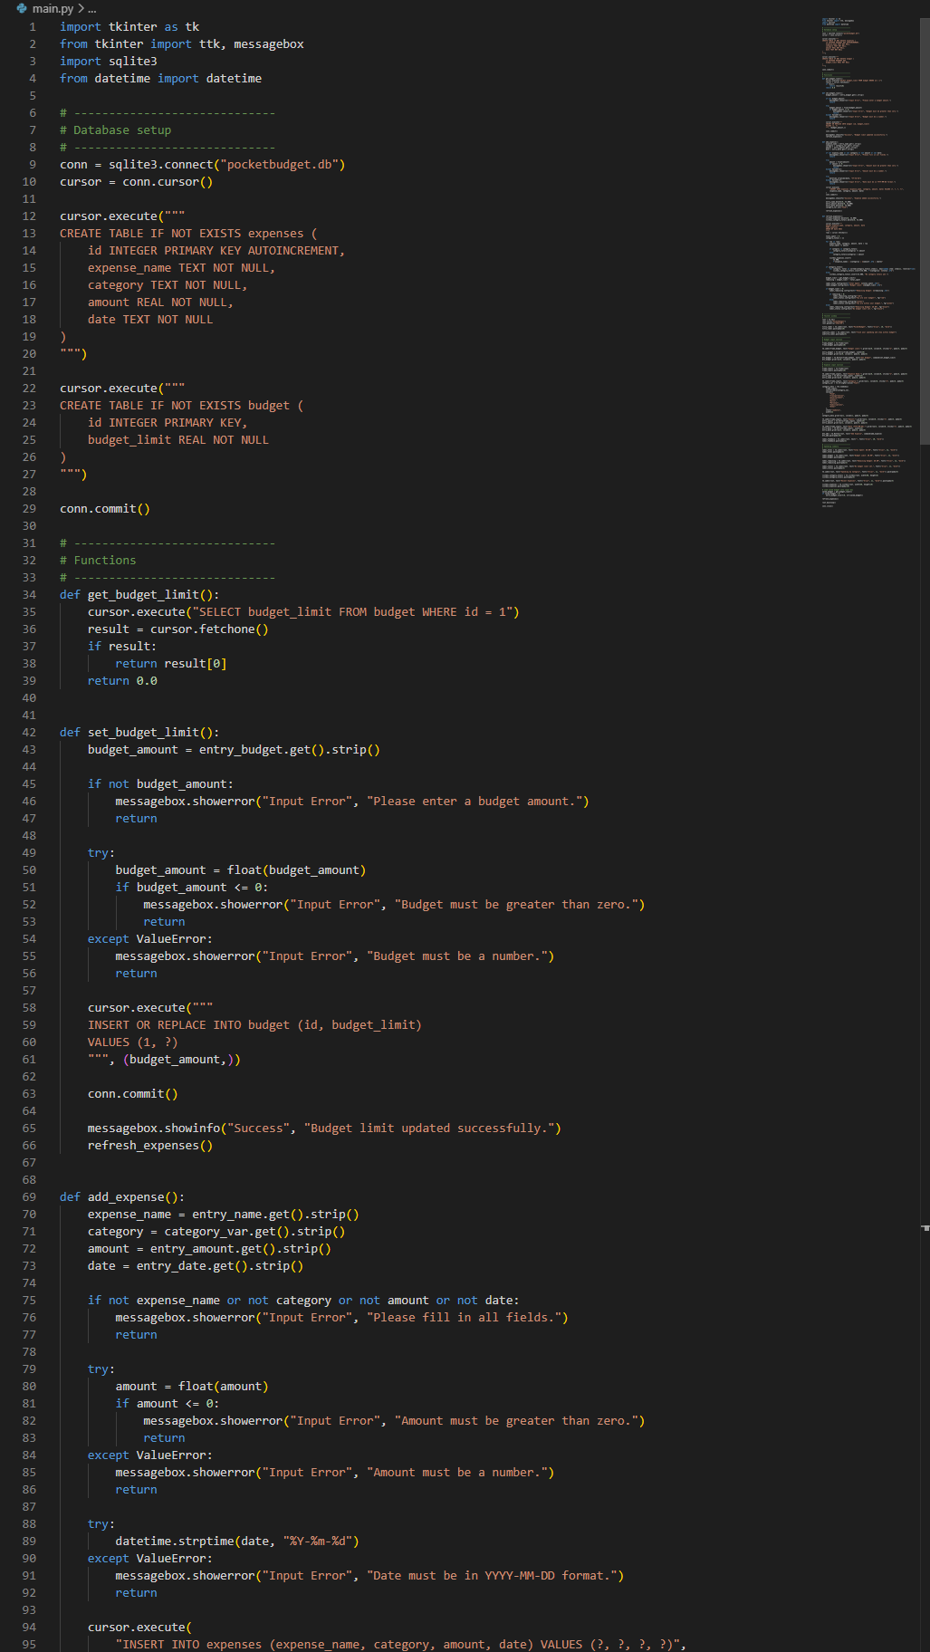
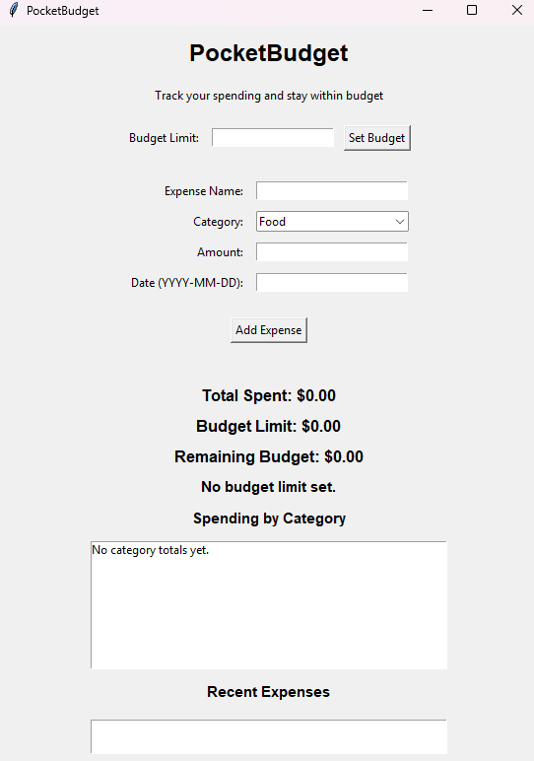
PocketBudget Jack Hubbard
A simple student budgeting app that helps users track expenses, organize spending, and stay in control of their money.

